Slide 1

SAP FICO
Accounts Receivables
(Customer A/c)
And
Accounts Payables
(Vendor A/c)

Slide 2
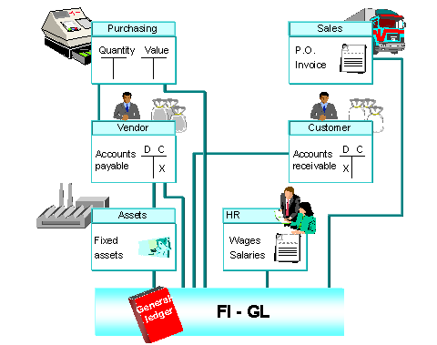

Slide 3
Accounts Receivables
(Customer accounting)
All records of customer (master and transactions) are handled independently in AR module.
Though the AR works independently these transactions are updated in the general ledger automatically at the same time.
Separate reports are available to access customer details such as -
- Customer analysis
- Aging report (due date analysis)
Individual customer balances
contn…

Slide 4
Accounts Receivables
(Customer accounting)
Generally all the basic entries will be entered in the Sales and Distribution module and then subsequently will be passed to FI automatically. So the documents from SD module are called as reference (base) documents.

Slide 5
Account Group for customer
Customers are grouped together in the customer account group.
This group are maintained according to the type of customer, the way business transactions are dealt with the same.
It contains information like –
- General Data : Name, address, and other
details
- Company code data : Accounting
information
- Sales area data : Related to sales department.

Slide 6
These groups are then assigned to each other. This functionality is called as ‘Partner function’ which is maintained in the SD module.
Normally customers are categorized into –
- Sold-to-party (to whom product is sold)
- Ship-to-party (to whom product is delivered)
- Bill-to-party (to whom Invoice is send)
- Payer (from whom payment is collected)

Slide 7
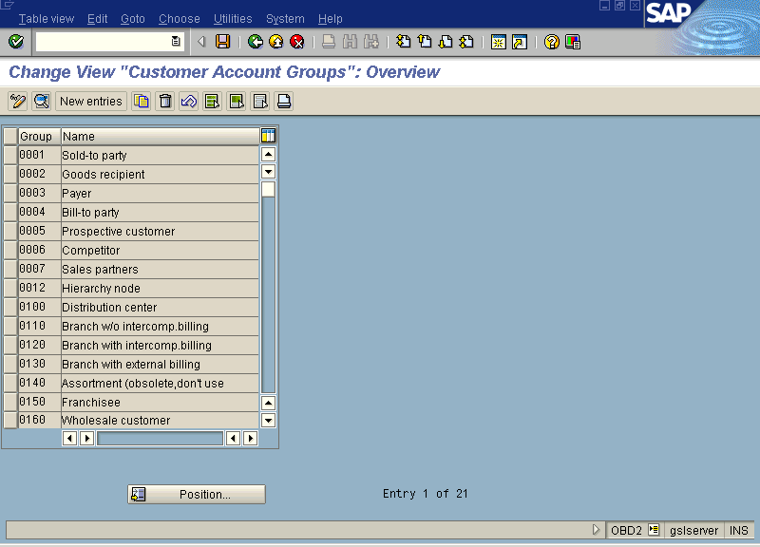

Slide 8
Number range intervals for customers
To identify the customer master record, these numbering system is used. The code or the number will be generated by the system (internally) or user can give the code or number while creating the master record (externally).
This number range interval then needs to assign to each customer group.

Slide 9
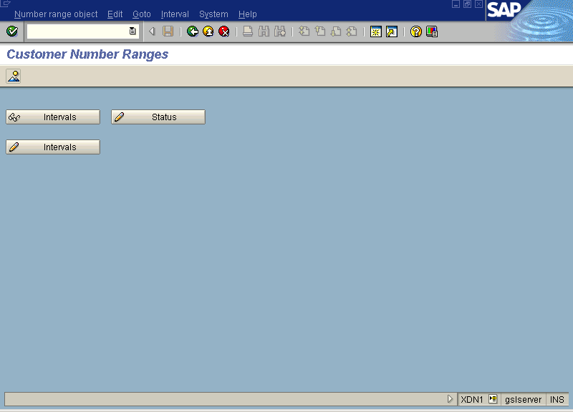

Slide 10
Customer master record
From AR section of FI, customer master record can be maintained. Generally the master record created in the SD, and then extended in the FI.
Different screens are available to maintain the master record.
- Sales [VD01]
- FI (AR) [FD01]
- Both (central) [XD01]

Slide 11
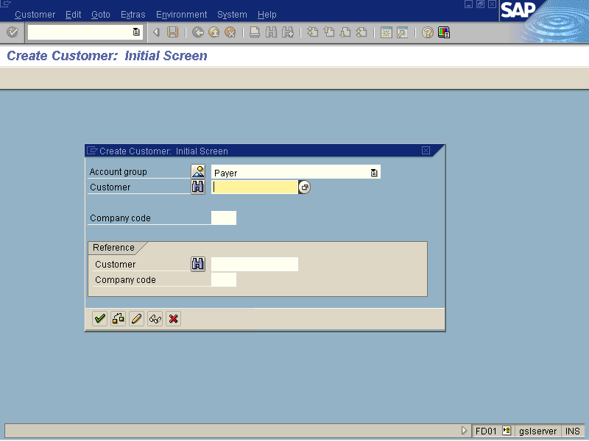

Slide 12
Transactions
Customer Invoice
It is also called as ‘Outgoing Invoice’. Actually this invoice is generated in the SD module and then passed (Release) on to the FI.
After invoice, all activities (e.g. payment, dunning, interest charging, correspondence) are taken care by FI.
In AR [FI] it is also possible to enter invoice directly which will be without referencing to any previous documents (like sales order or delivery).

Slide 13
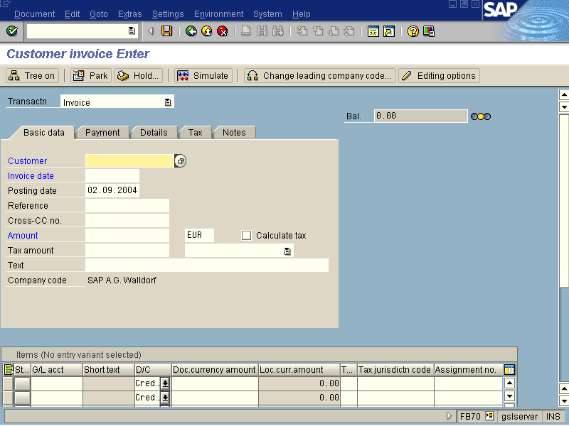

Slide 14
Payment can be handled in many ways –
- Full payment (Invoice will be cleared)
- Part payment (Inv. will not be cleared
until rest amount is received)
- Cash discount (Updates Discount a/c)
- Residual payment (Clears invoice and
creates open item for rest
balance)
- Down payment (Payment is received
prior to sending invoice)

Slide 15
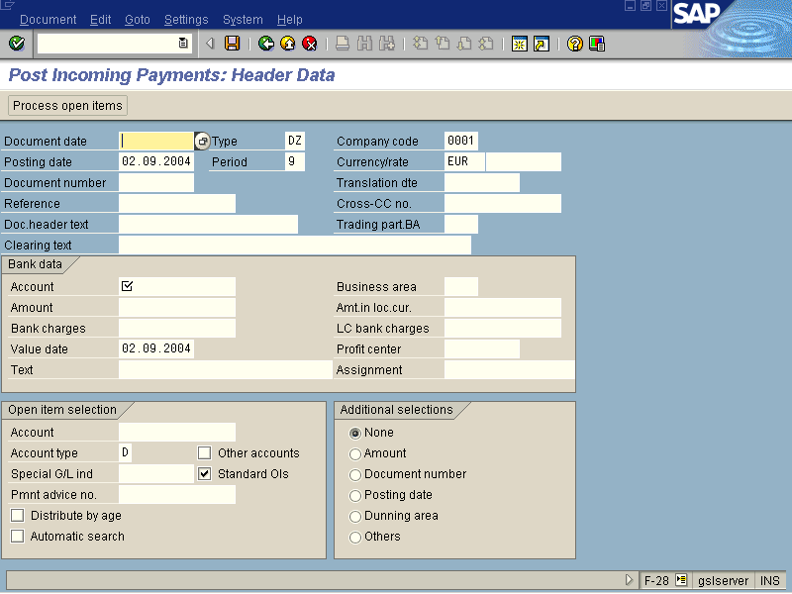

Slide 16
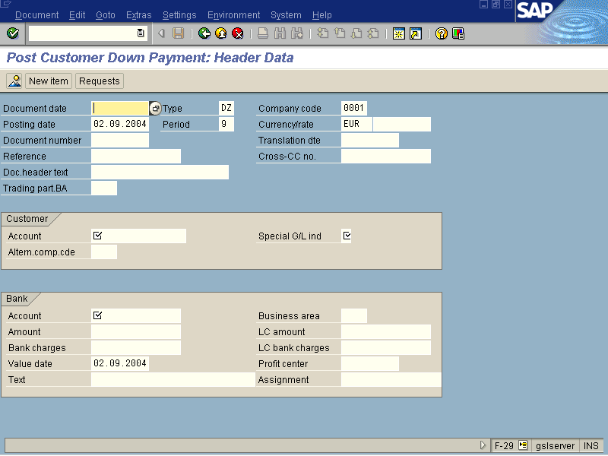

Slide 17
Dunning –
Dunning stands for sending reminders for recovery. The dunning procedure you need to maintain allows you to set various parameters such as –
How many times?
When i.e. with what interval?
Any dunning charges applicable?
Interest to be charged?
Legal notice is to be sent?

Slide 18
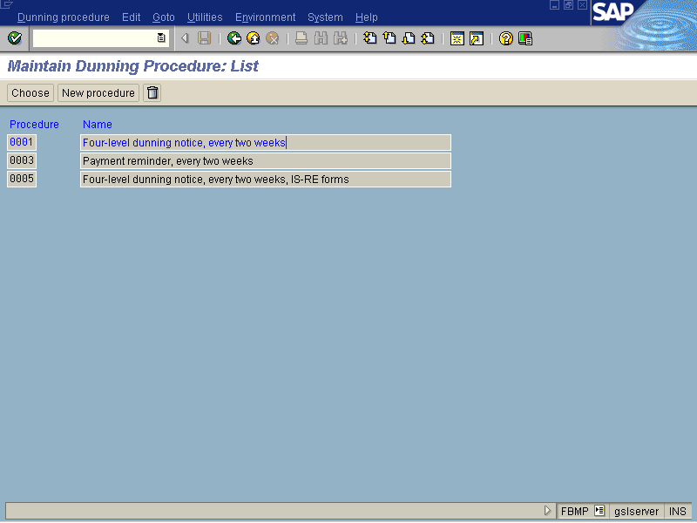

Slide 19
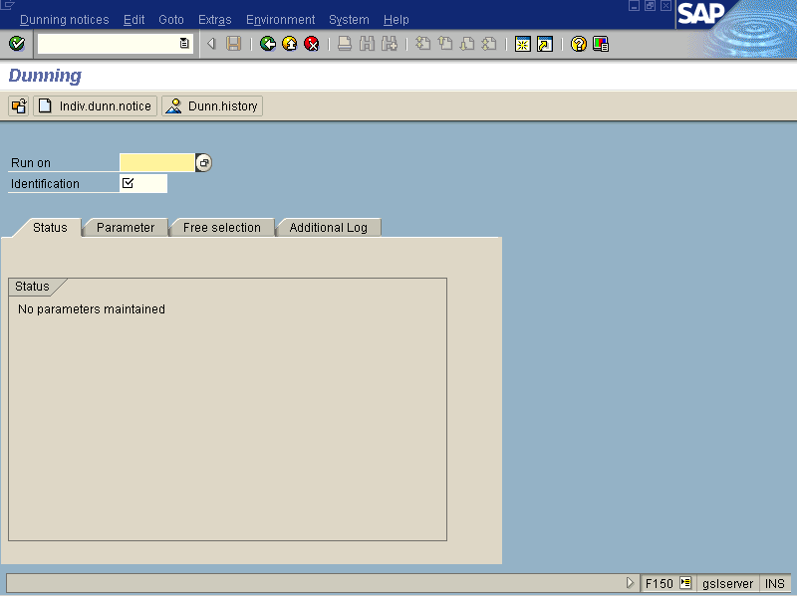

Slide 20
Terms of Payment
The terms of payment are maintained to define credit days limit in days. It also allows you to give or take cash discount if at all required along with rate of discount.
The terms of payment can used for customer as well as vendor.

Slide 21
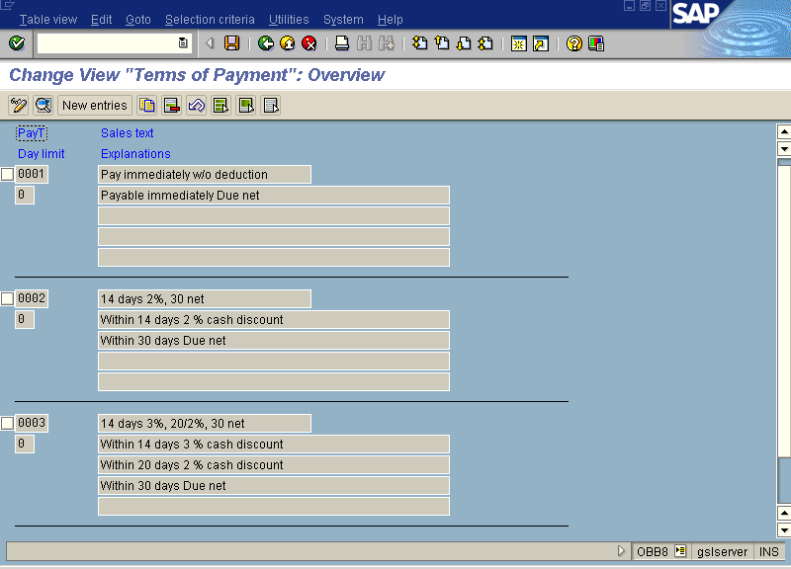

Slide 22
Interest calculation
This procedure allows you to calculate interest on outstanding invoices against particular customer.
You can set various parameters such as –
- Which calendar to be considered?
- Whether only debit items to be consider?
- What is the rate of interest?
And so on..
The entry of interest will be passed through batch input session and update the customer account as well.

Slide 23
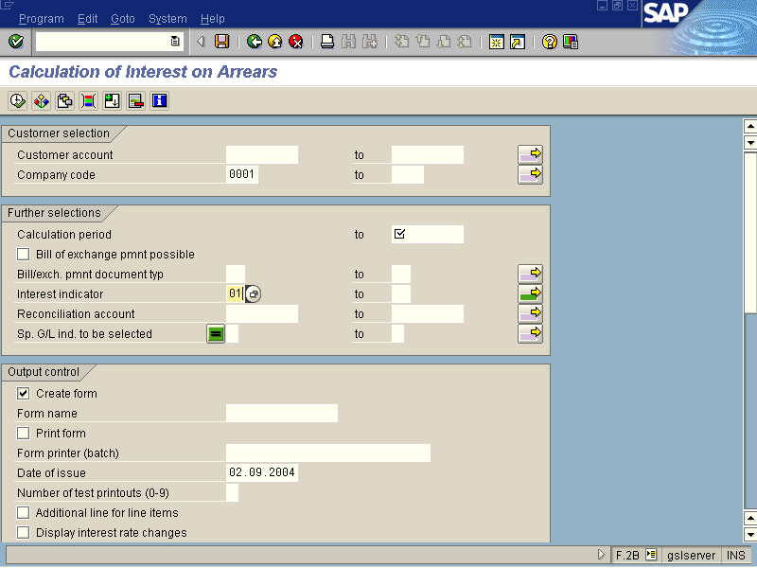

Slide 24
Accounts Payables
(Vendor Accounting)
The functionality of AP module is exactly opposite to the AR.
All records of vendor (master and transactions) are handled independently in AP module.
Though the AP works independently these transactions are updated in the general ledger automatically at the same time.
Separate reports are available to access customer details such as -
- Vendor analysis
- Individual vendor balances
contn…

Slide 25
Accounts Payables
(Vendor Accounting)
Generally all the basic entries will be entered in the Materials Management module and then subsequently will be passed to FI automatically. So the documents from MM module are called as reference (base) documents.
The major area handled by MM module is stock (quantity and value) updating which is NOT by AP.

Slide 26
In short, these AR and AP sub-ledgers are called as an extension to SD and MM modules.
The receipts and payments are taken care by AR and AP. So these entries by means of Bank which is another sub-ledger, reaches to general ledger. Simultaneously customer and vendor accounts will be cleared from outstanding list.

Slide 27
Banks
This sub-ledger also called as House bank (bank details of your companies) .
This sub-ledger allows you to maintain detail information of your companies bank account and transactions passed with the same.
This sub-ledger has following features –
- Payment methods
- Check printing
- Amount limits (maximum and minimum)
- Bank statements (Reconciliation statement)
- Automatic payment program

Slide 28
Master Data
First of all, you need to declare your bank details of the company (like bank, branch, account id, currency, payment methods, amount limits and so on).

Slide 29
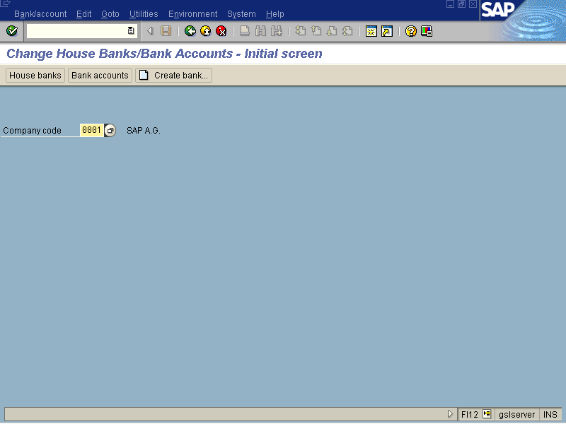

Slide 30
Automatic payment program
Instead of using manual payment method to pay for more than one invoice in single activity, you can use ‘Automatic payment program’ after configuration.
You need to configure –
- Your company details
- Minimum amount to be paid/received
- Foreign currency dealings allowed or not?
- Payment methods (printing program)
- GL accounts, ranking order and so on…

Slide 31
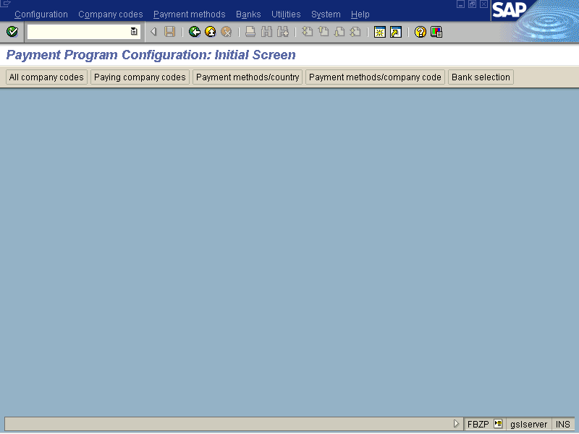

Slide 32
